Slide 1



Slide 2









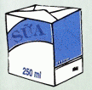

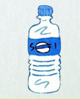
Remembering pictures
a
b
c
d
e
f
g
h
i
k
j
l

Slide 3

rice
noodles
meat
chicken
fish
vegetables
oranges
bananas
Orange juice
milk
soda
water

Slide 4

UNIT 11. What do you eat?
Lesson 5: B4-5.-6

